Slide 1
Math for Intro to DL
Review in 5 min

Slide 2
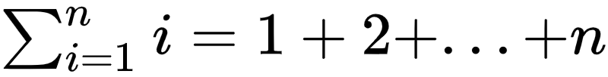
Summation
Summation is denoted by using Σ notation, where Σ is an enlarged capital Greek letter sigma. For example, the sum of the first n natural integers can denoted as

Slide 3
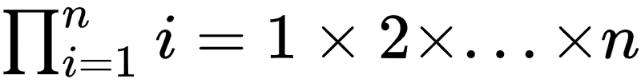
Product
Pi Notation, or Product Notation, is used in mathematics to indicate repeated multiplication. For example,

Slide 4
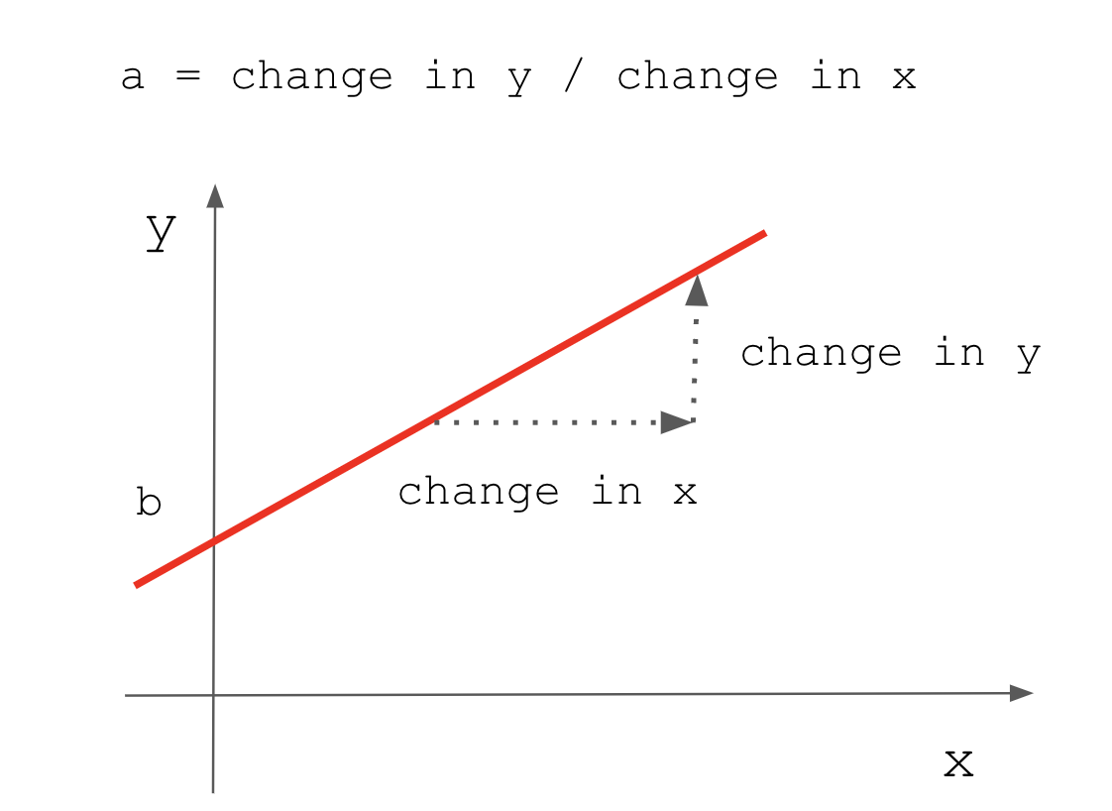
Linear Function
A function is a mathematical concept that describes the relationship between two sets. When there are variables x and y, if x changes, y indicates what rule changes. Usually, a function is expressed as y=f(x) using the function f and the variable x.
A linear function is a case in which y is expressed as a linear expression with respect to x. For example, it can be expressed as the following function expression.
y=ax+b (a not = 0)
If x is a linear form, a must be nonzero for x to remain linear.
In the linear function formula y=ax+b, a is the slope and b is the y-intercept. The slope refers to the degree of inclination, and the slope a of the graph is determined according to how much the y value increases when the x value in the figure increases. The y-intercept is the point at which the graph intersects the y-axis. In the figure, the y-intercept that intersects the y-axis is b.

Slide 5
Linear Function
Here are some real-life applications of the linear function.
A movie streaming service charges a monthly fee of $4.50 and an additional fee of $0.35 for every movie downloaded. Now, the total monthly fee is represented by the linear function f(x) = 0.35x + 4.50, where x is the number of movies downloaded in a month.
A t-shirt company charges a one-time fee of $50 and $7 per T-shirt to print logos on T-shirts. So, the total fee is expressed by the linear function f(x) = 7x + 50, where x is the number of t-shirts.

Slide 6
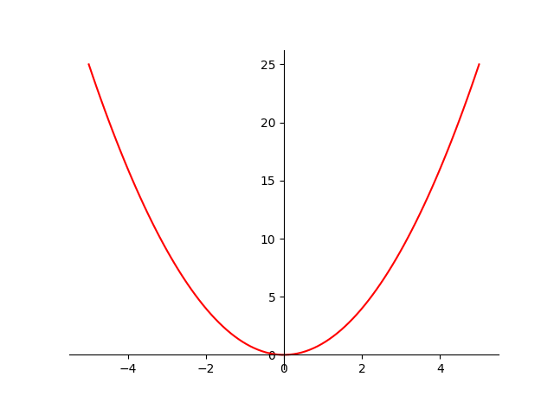
Quadratic Function
A quadratic function is a polynomial function with one or more variables in which the highest exponent of the variable is two. Since the highest degree term in a quadratic function is of the second degree, therefore it is also called the polynomial of degree 2. A quadratic function has a minimum of one term which is of the second degree. It is an algebraic function.
The parent quadratic function is of the form f(x) = x² and it connects the points whose coordinates are of the form (number, number²). Transformations can be applied on this function on which it typically looks of the form f(x) = a (x - h)² + k and further it can be converted into the form f(x) = ax² + bx + c. Let us study each of these in detail in the upcoming sections.

Slide 7
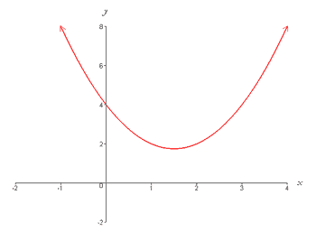
Quadratic Function
If you move the graph in parallel by h in the x-axis direction and k in the y-axis direction, it is as follows.
y = a(x - h)² + k
k
h

Slide 8
Ordinary differential, Instantaneous rate of change, and Gradient
Derivative, in mathematics, is the rate of change of a function with respect to a variable. Derivatives are fundamental to the solution of problems in calculus and differential equations. The derivative tells us the rate of change of one quantity compared to another at a particular instant or point (so we call it "instantaneous rate of change")
y = f(x)
Gradient: f’(a)
f(a)
a

Slide 9
Instantaneous speed
The derivative predicts change. Ok, how do we measure speed (change in distance)?
Officer: Do you know how fast you were going?
Driver: I have no idea.
Officer: 95 miles per hour.
Driver: But I haven't been driving for an hour!
We clearly don't need a "full hour" to measure your speed. We can take a before-and-after measurement (over 1 second, let's say) and get your instantaneous speed. If you moved 140 feet in one second, you're going ~95mph. Simple, right?

Slide 10
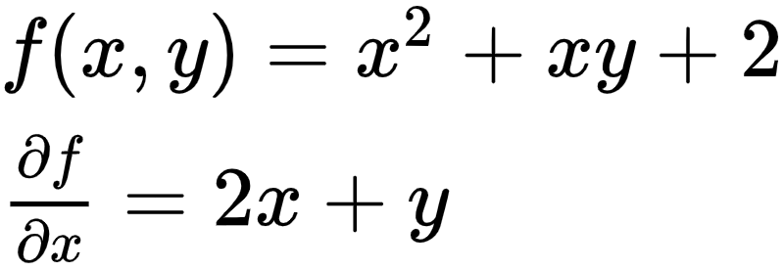
Partial Differentiation
Differentiating a function of multiple variables with respect to only one variable is partial differentiation.
Instead of differentiating for all variables, we differentiate only one variable we want and treat all other variables as constants.
For example, if you only want to differentiate on x, write the equation as follows.

Slide 11
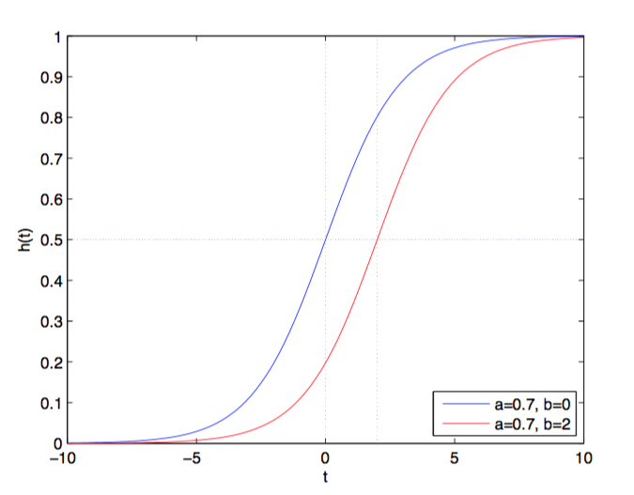
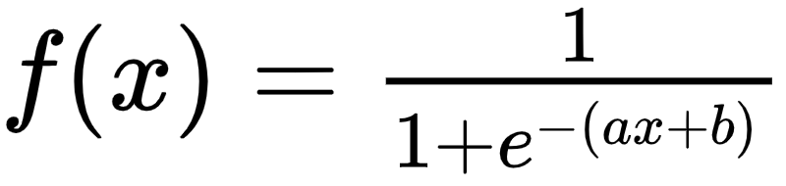
Sigmoid Function
f(x)
a is a coefficient to adjust the slope
b is to adjust the position of the center
x

Slide 12
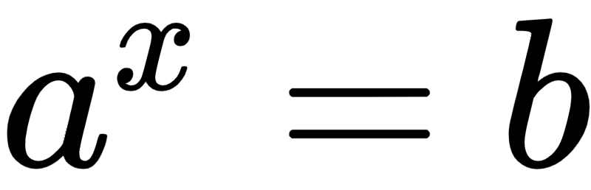
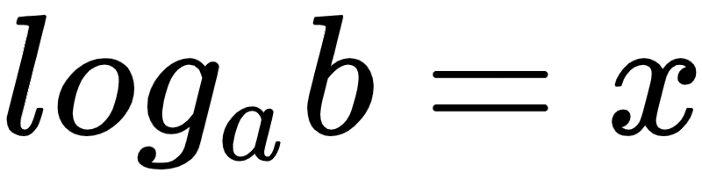
Logarithm
To understand the logarithm, let's start with the exponent.
If a is raised to the power of x and it’s equal to b, the expression is
Let's say you know a and b but don't know x. In that case, you can use log to get it.

Slide 13
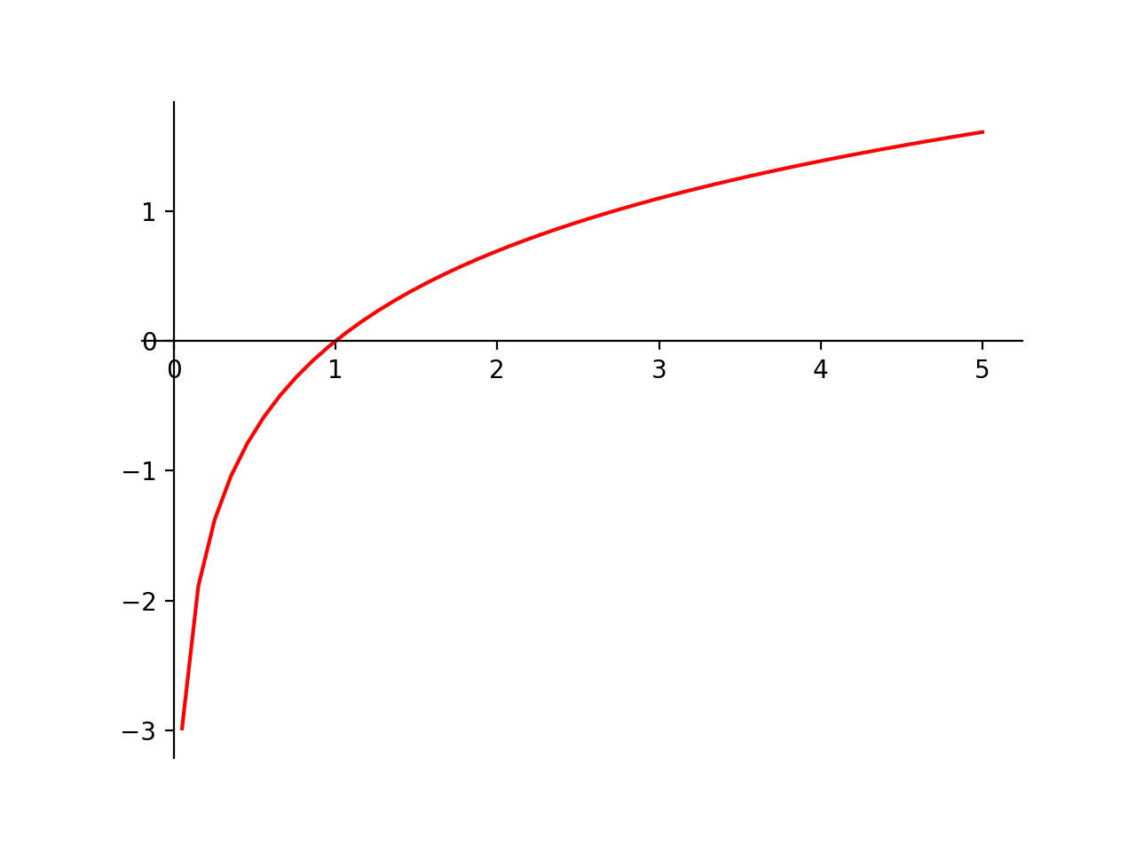
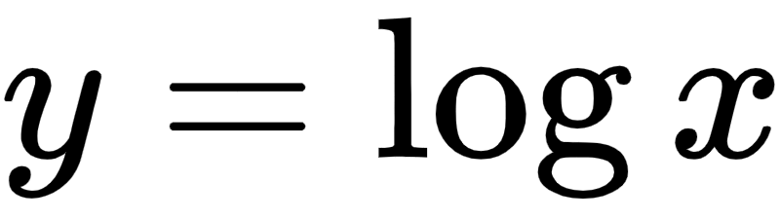
Log function (natural log)

Slide 14
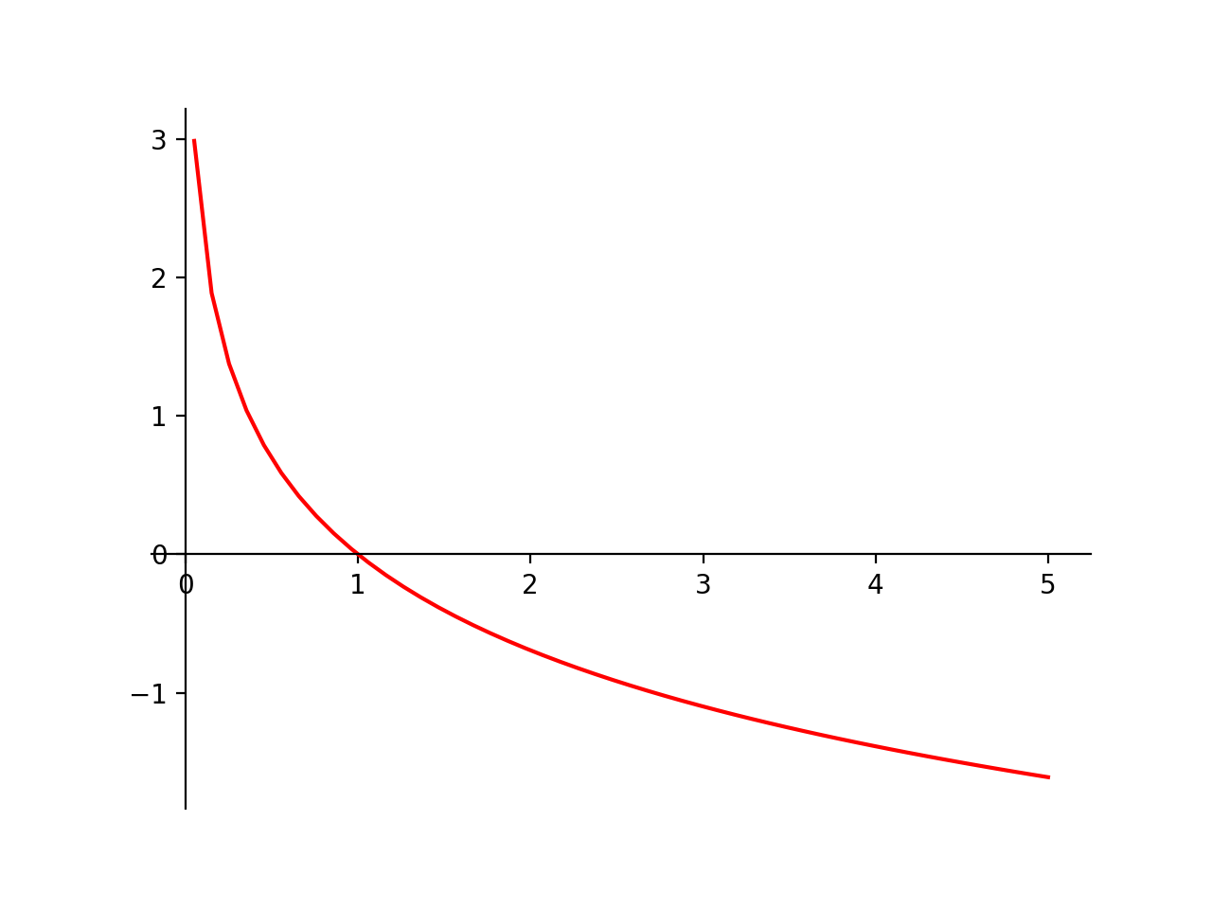
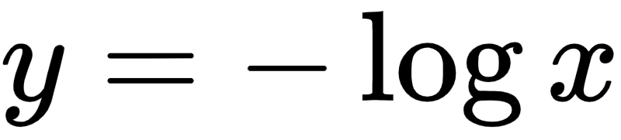
Log function

Slide 15
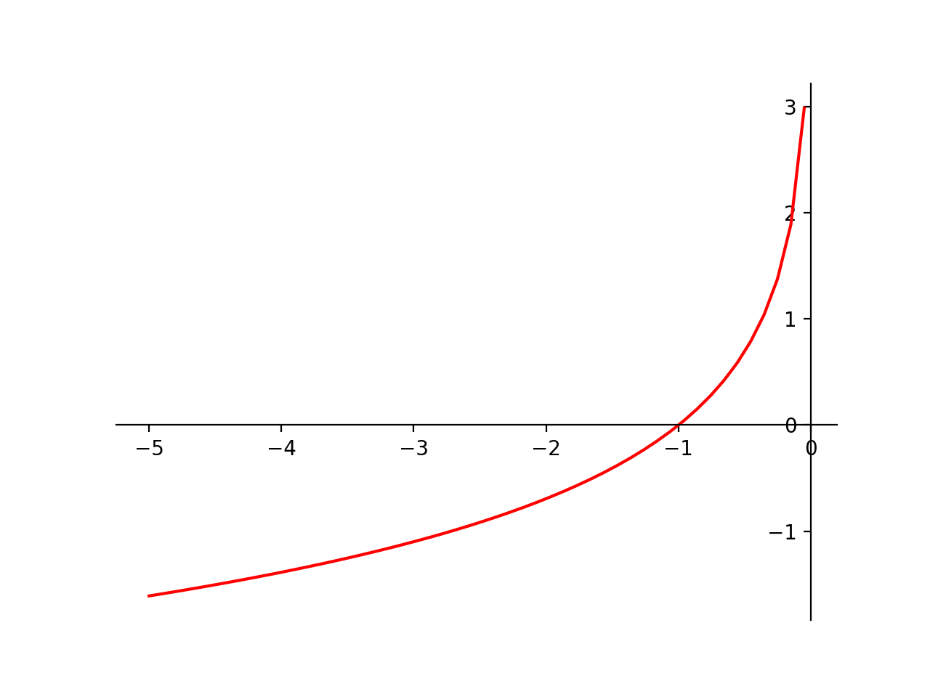
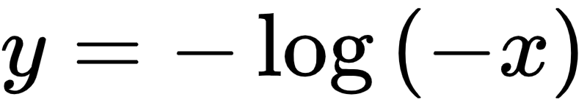
Log function

Slide 16
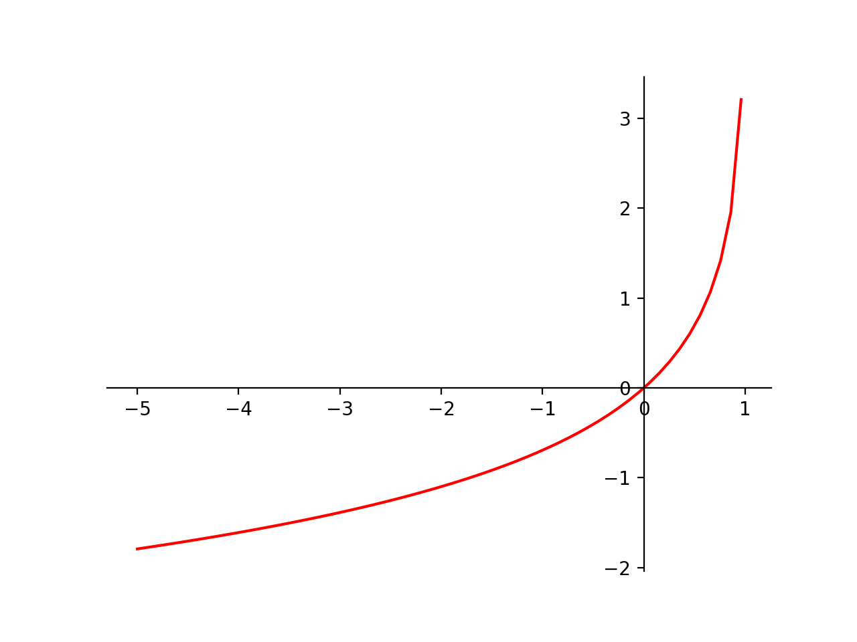
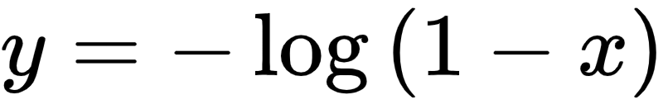
Log function

Slide 17
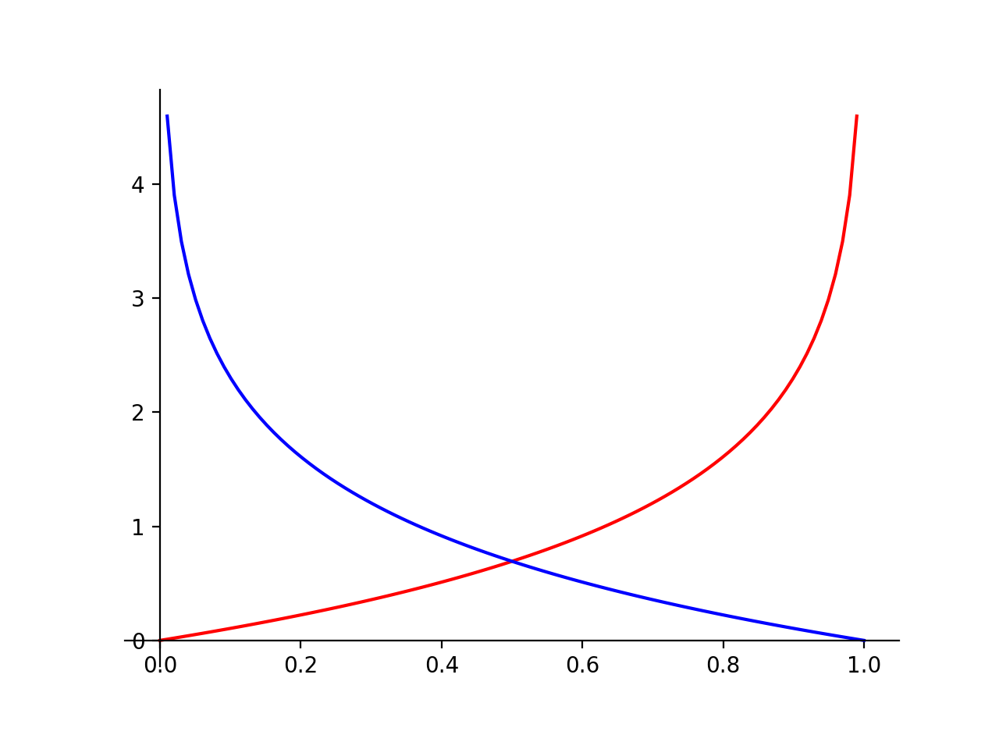
Log functions

Slide 18
Lab 2 - 3
Using matplotlib package in python, please plot two log functions below. Submit source code and output image file.

Slide 19
Hint
import matplotlib.pyplot as plt
import numpy as np
np.seterr(divide = 'ignore')
x = np.linspace(0,1)
y1 = -np.log(x)
y2 = -np.log(1-x)
plt.plot(x, y1)
plt.plot(x, y2)
plt.show()

